Slide 2
Read across mock submissions prepared by CS4
Egmond, 12.02.2019

Slide 3
NAM-supported read across
NAM data
to support read across (RAX) arguments
Input
Predict toxicity of an “unknown” mitochondrial inhibitor, using data from mitotoxicants of known toxicity
Task
Regulatory mock submission (focusing on neurotoxicity),
based on NAM data, literature and WoE arguments
Output
Study 1: rotenoids – predict toxicity of deguelin, a rotenone analogue
Study 2: strobilurins – arguments for non-neurotoxicity of azoxystrobin

Slide 4
Study 1: leading to mock submission dossier for the rotenoid deguelin

Slide 5
Problem formulation
Identification and characterization of parkinsonian hazard liability of deguelin
Purpose
Replace animal tests (e.g. OECD TG424 (neurotoxicity))
Use available AOP#3 to guide test strategy
Use NAM to reduce overall RAX uncertainty
Background
Rotenone has known neurotoxicity and liability to trigger PD motor deficits
Deguelin is structurally similar to rotenone

Slide 6
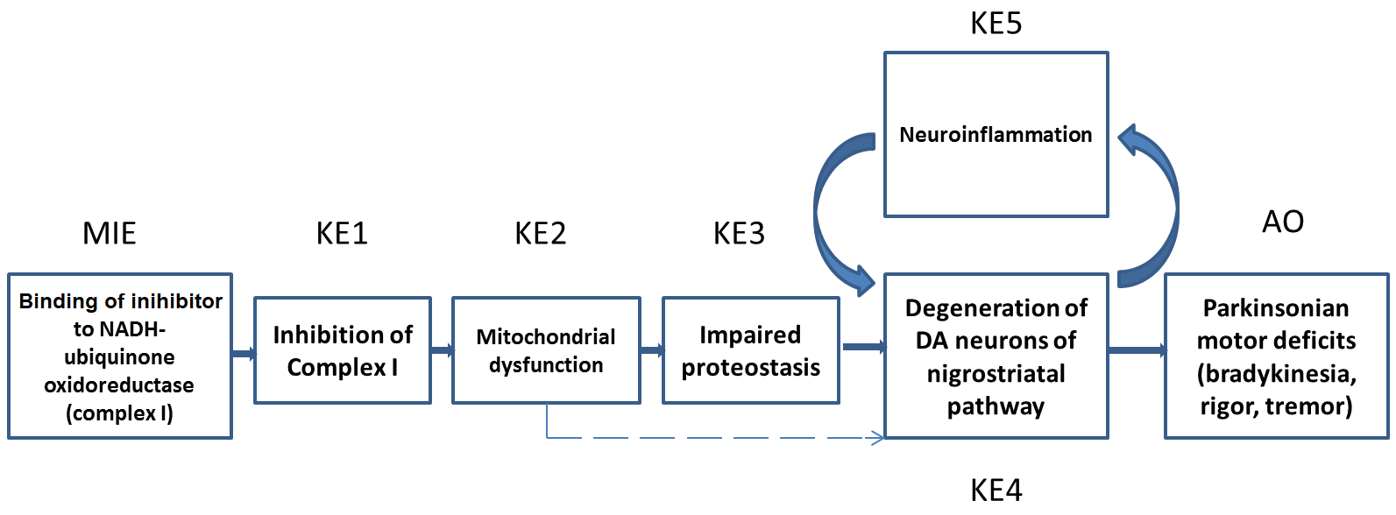
Strategy of RAX on rotenoid compounds
Rotenone
(data rich)
Read
across
Deguelin (data poor)
Source
Target
Define source and target chemicals
Relevant human health endpoint: parkinsonian motor deficits
AOP#3 as background structure to guide test selection
(AOP#3 is endorsed by the OECD and published in detail (Terron 2018))
Combine hazard data with toxicokinetics data for toxicity prediction
Perform uncertainty analysis
Chemicals:
rotenone
deguelin
Exposure
Metabolism
(ADME)

Slide 7
Background information for RAX on rotenoid compounds
 | Rotenone | Deguelin
Occurrence | - Naturally occurring pesticide, also produced industrially - Since 2008 no more European authorization (Piscicide use only in Norway) | - Analogue of rotenone, found in natural products (cubé resin) containing rotenone
Exposure | - Exposure of workers to it is statistically associated with increased PD (Dhillon 2008, Tanner 2011, etc) | - No human data
Experimental data | - Tool compound to trigger PD symptoms in vivo and in vitro | - In vitro studies suggest similar target as for rotenone

Slide 8
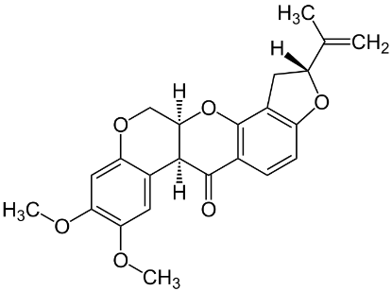
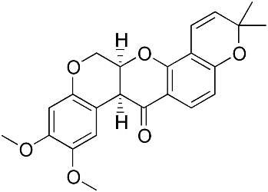
Structural similarity of rotenone and deguelin
 | Rotenone | Deguelin
Structure
Chemical formula | C₂₃H₂₂O₆
Hydrogen bond acceptor | 6
Hydrogen bond donor | 0
logP | 4.1 | 4.3
H₃C
CH₃
closely related structures and phys-chem properties
Notes:
Degulein little bit more hydrophilic

Slide 9
Comparison of rotenone and deguelin, guided by MIE/KE tests
Notes:
Degulein little bit more hydrophilic

Slide 10
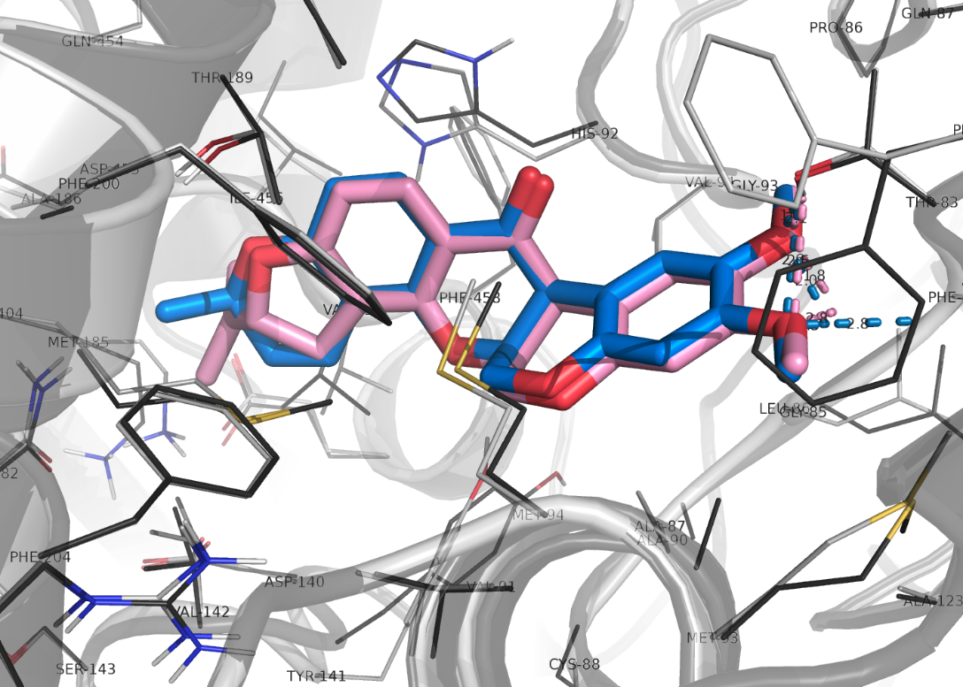
MIE: Binding to mitochondrial complex I
Binding site of rotenone at cI known
Cryo-EM structure of human cI known
Test: docking of rotenone and deguelin into this structure (in silico)
Confirmation of a common binding mode of rotenone and deguelin
deguelin
rotenone

Slide 11
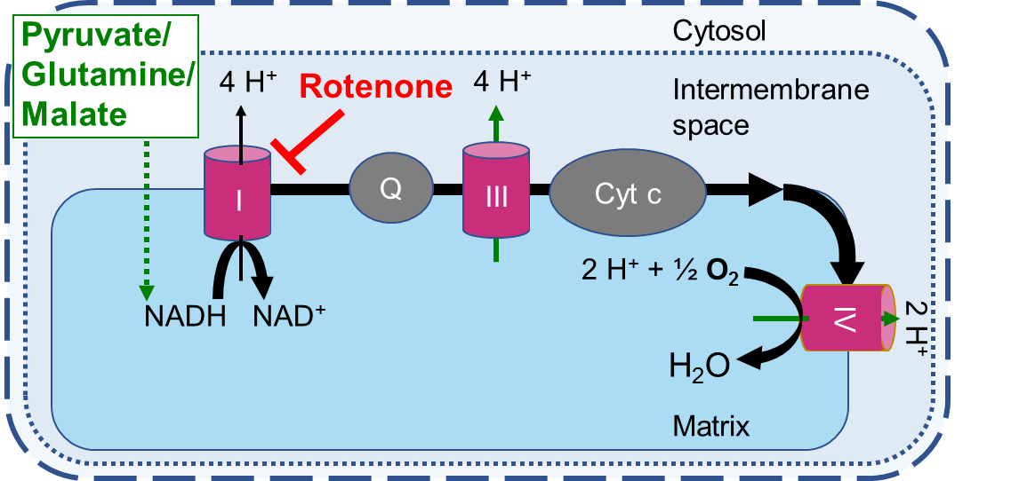
KE1: Inhibition of complex I
Use of Seahorse flux analyzer to measure mitochondrial activity in human neurons (LUHMES)
Rotenone and deguelin inhibit cI in mitochondria and intact cells (confirmed in second cell type & assay)
Rotenone is about 3-fold more potent

Slide 12
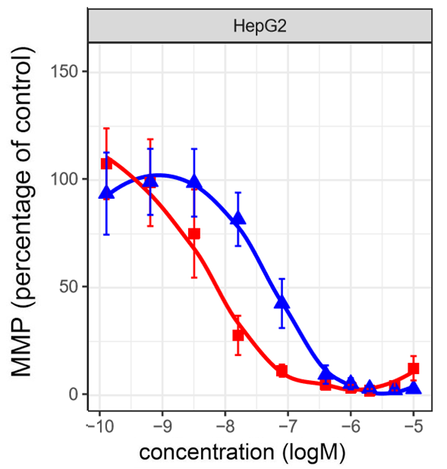
KE2: mitochondrial dysfunction – loss of membrane potential
Measurement of mitochondrial membrane potential (MMP) in live cells
Rotenone and deguelin decrease MMP (3 different cell systems)
Mitochondrial dysfunction confirmed by compensatory increase in glycolysis (lactate production)
Rotenone 3-10x more potent
deguelin
rotenone

Slide 13
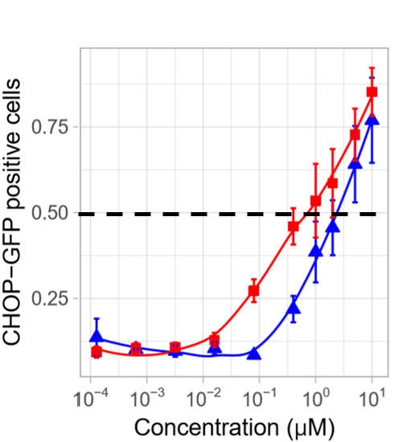
KE3: impaired proteostasis
Assessment of proteotoxic stress by measurement of indicative reporter gene (CHOP)
Rotenone slightly more potent than deguelin
Confirmed by independent assay and cell system
rotenone
deguelin

Slide 14
KE4: dopaminergic degeneration
Measurement of neurite degeneration in dopaminergic neurons (LUHMES)
Rotenone about 3-fold more potent than deguelin
Confirmed by other death endpoints
Confirmed in an alternative neuronal test system

Slide 15
ADME parameters/ PBPK modelling
Absorption & Distribution
Data are highly similar for rotenone and deguelin
Protein binding
Rotenone and deguelin are very similar
Blood/plasma partitioning similar
Metabolism & Elimination
Data suggest CYP 2C19 and 3A4 as major pathways
Rotenone and deguelin are very similarly metabolized
Mainly excreted via faeces and urine (ca. 75%)
IVIVE/PBPK modelling
Prediction of toxic doses (in human), resulting in 50% neurite loss (in vitro) is
7 mg rotenone, (oral exposure, in human)
28 mg deguelin, (oral exposure, in human)

Slide 16
Uncertainty evaluation
Topic | Details | Uncertainty
Mode of action | cI inhibitors, for rotenone known, for deguelin strong in vitro and in silico data | Low
Similarity of chemicals used for read across | Highly similar phys-chem parameters, same toxicophore, … | Low
Quality of end point data | 1) Uncertainty of each applied assay 2) Following the AOP 3) Reflection of KEs by assays | Low Low Low/medium
Toxicokinetics | - Metabolism (ADME) similar CYP 2C19 polymorphism (poor metabolizer) | Low
Gaps | - Unknown transporters/processes cannot be excluded for ADME; - Unknown alternative targets to be further explored (by transcriptomics)
Overall low uncertainty, despite low number of used analogs

Slide 17

Conclusions on deguelin RAX
Hazard data and toxicokinetics predictions (in vitro and in silico) are similar for rotenone and deguelin
Uncertainties are low
NAMs have been used to reduce uncertainties of RAX
Data from our study (in vitro and in silico) agree well with known potency difference of in vivo data
our regulatory conclusion
Deguelin has the same hazard properties as rotenone, but a slightly lower potency (factor 3).
Thus its acceptable exposure/intake should be max. 3 times higher than for rotenone.

Slide 18
Study 2: leading to mock submission dossier for azoxystrobin

Slide 19
Problem formulation
Waiving of repeat-dose neurotoxicity study (TG 424) for azoxystrobin based on read across to other strobilurins
Strobin I
Strobin II
Azoxy-strobin
Antimycin
Strobin III
Strobin IV
Source chemicals
Non-neurotoxic (in vivo)
Target chemical
„Anti-source“
Neurotoxic (in vivo)

Slide 20
Summary on azoxystrobin RAX
NAM data for all examined strobins indicate:
Same mode of action (cIII inhibition) and similar toxophore
Same effects (impairment of oxygen consumption, neurite damage)
Closely related phys-chem. properties and metabolism
Brain exposure is low for all strobins
Antimycin A as ‘negative reference’, i.e. neurotoxicant: largely different biological properties compared to strobins
our regulatory conclusion
No evidence for a stronger neurotoxicity hazard of azoxystrobin, relative to the other strobins
Overall low/medium uncertainty

Slide 21
Overall conclusion
NAM can be used to improve RAX for hazard & risk assessment (more clarity, less uncertainty)
Essential: exact definition of regulatory problem and purpose of the RAX

